Slide 1
Digital Circuit Design and Analysis
115-1
Specialized Computational Architectures
Chung-An Shen(沈中安)
Department of Electronic and Computer Engineering
National Taiwan University of Science and Technology
Notes:
Time Table:
Slide 1 to 6 5min
Slide 7-9 4min
Slide 10-12 5min
Slide 13 1min

Slide 2
Specialized Architectures for Signal Processing
CORDIC Architecture
  To compute the rotation of a vector in the Cartesian coordinate system using only simplified shift-and-Add operations.
Systolic Array Architecture
  A network of processing elements (PEs) that rhythmically compute and pass data through the system.
  Usually operate with stationary data flows.
Case Studies
  Matrix Decompositions.

Slide 3
CORDIC Architecture
COordinate Rotation DIgital Computer (CORDIC)
  Originally developed by Jack E. Volder in 1959 for real-time navigation.
  Compute the rotation of a vector in the Cartesian coordinate system.
  Use much simplified shift-and-add to realize multiplications.
  Iterative scheme and could lead to extended latency.
  Applied to much extended applications.
  trigonometric
  hyperbolic and logarithmic functions
  real and complex multiplications
  Division
  square-root
  solution of linear systems
  eigenvalue estimation
  singular value decomposition
  QR factorization
  …etc
Pramod K. Meher et al., “ 50 Years of CORDIC: Algorithms, Architectures, and Applications,“ IEEE TCAS- I , vol. 56, no. 9, pp.1893-1907, 2009

Slide 4

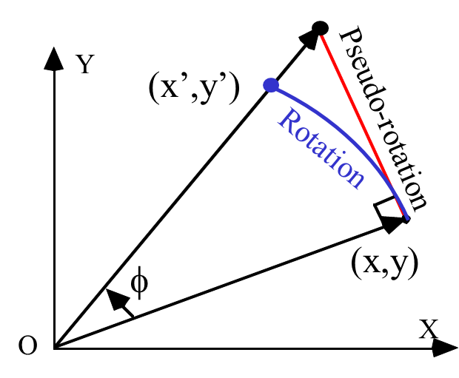
CORDIC Architecture
Vector Rotation
Y
(x’,y’)
(x,y)
φ
X
  cos(φ)
    Reduces the magnitude of the vector
  tan(φ)
    Rotates the vector
Pramod K. Meher et al., “ 50 Years of CORDIC: Algorithms, Architectures, and Applications,“ IEEE TCAS- I , vol. 56, no. 9, pp.1893-1907, 2009

Slide 5
CORDIC Architecture
Both of sin(φ) and cos(φ) can be computed using a series of rotations
Break ϕ into a series of angles α^{(i)}
[
]
[
]
[
]
[
]
cosφ
sinφ
cosφ_{m} − sinφ_{m}
sinφ_{m} cosφ_{m}
Shift
cosφ₀ − sinφ₀
sinφ₀ cosφ₀
1
0
=
…
ϕ = α ⁽¹⁾ + α ⁽²⁾ + . . . + α ^{(n)}
x^{(i+1)} = x^{(i)} cos α^{(i)} – y^{(i)} sin α^{(i)}
= cos(α^{(i)})[x^{(i)} – y^{(i)} tan α^{(i)}]
y^{(i+1)} = y^{(i)} cos α^{(i)} + x^{(i)} sin α^{(i)}
= cos(α^{(i)})[y^{(i)} + x^{(i)} tan α^{(i)}]
α⁽³⁾
α⁽²⁾
α⁽¹⁾
Pramod K. Meher et al., “ 50 Years of CORDIC: Algorithms, Architectures, and Applications,“ IEEE TCAS- I , vol. 56, no. 9, pp.1893-1907, 2009

Slide 6
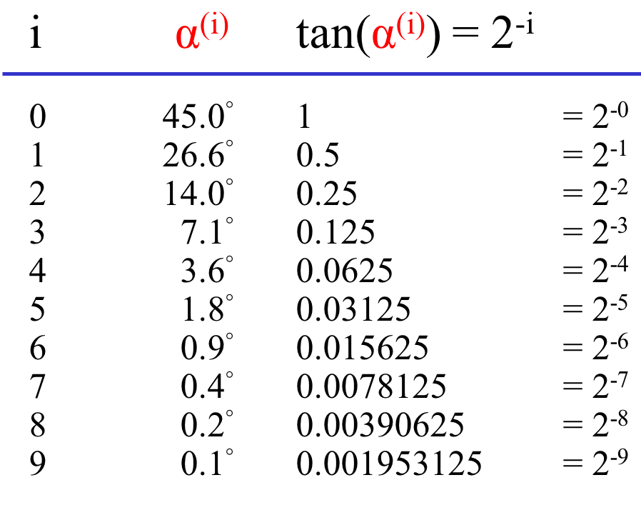
CORDIC Architecture
How to choose α ^{(i)} ?
How about this….
  Choose α ^{(i)} such that tan(α^{(i)}) = 2^{-i} ➔ α ^{(i)} = tan⁻¹(2^{-i})
  Multiplication can be realized by shift-and-add.
x^{(i+1)} = x^{(i)} cos α^{(i)} – y^{(i)} sin α^{(i)}
= cos(α^{(i)})[x^{(i)} – y^{(i)} tan α^{(i)}]
y^{(i+1)} = y^{(i)} cos α^{(i)} + x^{(i)} sin α^{(i)}
= cos(α^{(i)})[y^{(i)} + x^{(i)} tan α^{(i)}]
Pramod K. Meher et al., “ 50 Years of CORDIC: Algorithms, Architectures, and Applications,“ IEEE TCAS- I , vol. 56, no. 9, pp.1893-1907, 2009

Slide 7
CORDIC Architecture
An example of φ=30.0°
  Start with α⁽⁰⁾ = 45.0 (> 30.0)
  45.0 – 26.6 = 18.4 (< 30.0)
  18.4 + 14.0 = 32.4 (> 30.0)
  32.4 – 7.1 = 25.3 (< 30.0)
  25.3 + 3.6 = 28.9 (< 30.0)
  28.9 + 1.8 = 30.7 (> 30.0)
  . . .
Y
45°
30°
X
  φ = 30.0
  ≈ 45.0 – 26.6 + 14.0 – 7.1 + 3.6
  + 1.8 – 0.9 + 0.4 – 0.2 + 0.1
  = 30.1
Pramod K. Meher et al., “ 50 Years of CORDIC: Algorithms, Architectures, and Applications,“ IEEE TCAS- I , vol. 56, no. 9, pp.1893-1907, 2009

Slide 8
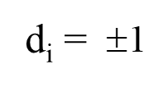
CORDIC Architecture
The direction term and the magnitude component
  ➔ Multiply this constant ONLY ONCE at the end
Two operating modes of the CORDIC:
  Rotation Mode (RM): A vector P₀ is rotated by an angle ϕ to obtain a new vector P_{n}
    To compute cos(ϕ) and sin(ϕ)
  Vectoring Mode (VM): A vector P₀ is rotated towards the x-axis so that the y component approaches zero
    To compute the magnitude or the rotated angle.
x^{(i+1)} = [x^{(i)} – d_{i}y^{(i)} 2^{-i}]K_{i}
y^{(i+1)} = [y^{(i)} + d_{i}x^{(i)} 2^{-i}]K_{i}
Pramod K. Meher et al., “ 50 Years of CORDIC: Algorithms, Architectures, and Applications,“ IEEE TCAS- I , vol. 56, no. 9, pp.1893-1907, 2009

Slide 9
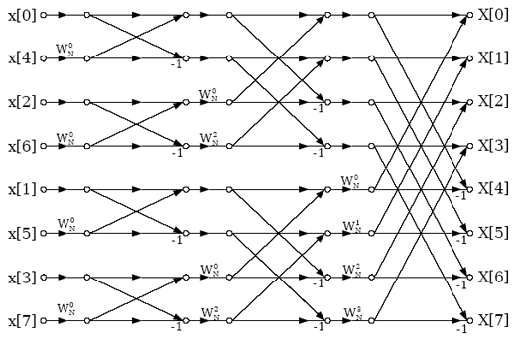
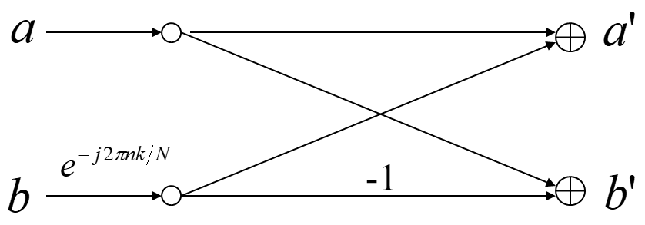

CORDIC Architecture
An example of CORDIC: Fast Fourier Transform (FFT)
  A 8-point FFT structure:
butterfly operation
Pramod K. Meher et al., “ 50 Years of CORDIC: Algorithms, Architectures, and Applications,“ IEEE TCAS- I , vol. 56, no. 9, pp.1893-1907, 2009

Slide 10




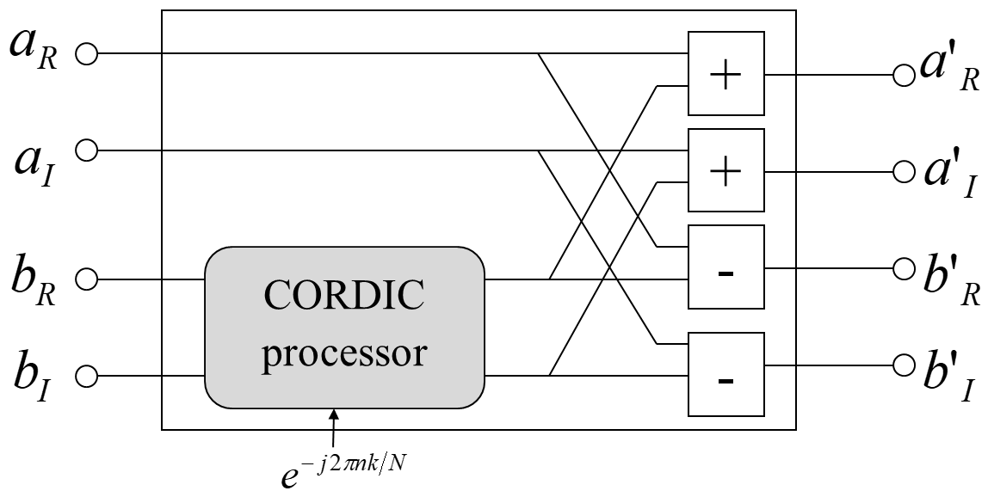
CORDIC Architecture
An example of CORDIC: Fast Fourier Transform (FFT)
  The butterfly operation can be realized by using CORDIC processor
  The Twiddle Factor
➔
Pramod K. Meher et al., “ 50 Years of CORDIC: Algorithms, Architectures, and Applications,“ IEEE TCAS- I , vol. 56, no. 9, pp.1893-1907, 2009

Slide 11
CORDIC Architecture
The architecture of CORDIC processor
a(n-1)
a(1)
a(0)
X-Reg
Y-Reg
shifter
shifter
Z-reg
+/-
+/-
X(i+1)
Y(i+1)
Z(i+1)
Pramod K. Meher et al., “ 50 Years of CORDIC: Algorithms, Architectures, and Applications,“ IEEE TCAS- I , vol. 56, no. 9, pp.1893-1907, 2009

Slide 12
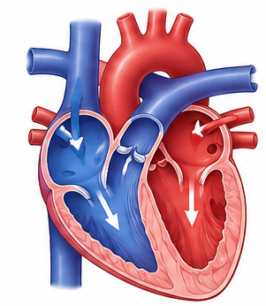
Systolic Array Architecture
The systolic comes from a medical term systole.
A heartbeat pulses blood continuously pumping through the heart.
H. T. Kung (孔祥重) and Charles E. Leiserson first introduced and popularized the concept of systolic arrays in their foundational 1978/1979 report titled "Systolic Arrays (for VLSI)".

Slide 13
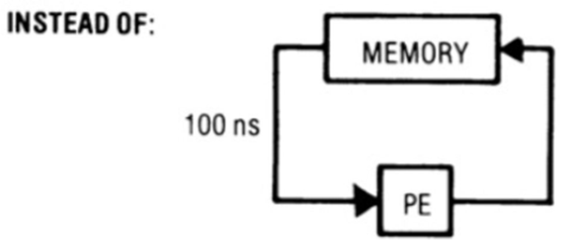

Systolic Array Architecture
Synchronized local computation and regular data movement
A network of processing elements (PEs) that rhythmically computes and passes data through the system.
The PEs regularly pump data in and out of the array and multiple PEs to maximize processing per memory access.
  A specialized form of parallel computing.
  Features modularity and regularity
  PEs are uniform, fully pipelined, and synchronized.

Slide 14

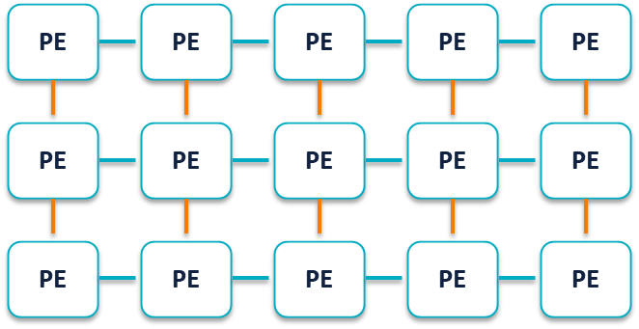
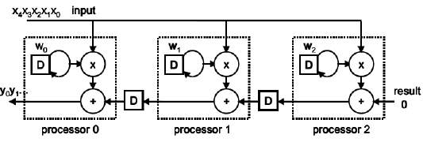
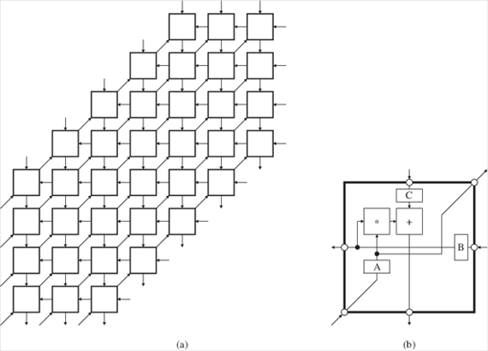
Systolic Array Architecture
Systolic Array and PE structures.
  PE usually contains MAC operators and registers.
  Each PE has a space-time representation
  The dataflow within PE is usually very simple.
    receive → compute → register → forward
broadcast inputs, move results, weights stay

Slide 15
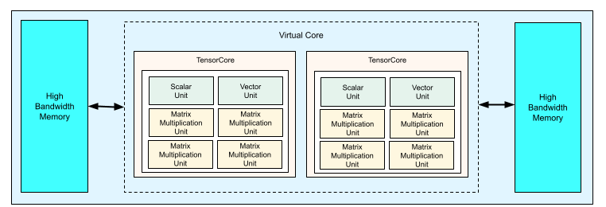
Systolic Array Architecture: Example
Tensor Processing Unit (TPU) of Google
  TPUs are application specific integrated circuits (ASICs) designed by Google to accelerate machine learning workloads.
  TPUs are designed to perform matrix operations quickly making them ideal for machine learning workloads.
  The heart of the TPU: A systolic array.
https://docs.cloud.google.com/tpu/docs/system-architecture-tpu-vm
https://cloud.google.com/blog/products/ai-machine-learning/an-in-depth-look-at-googles-first-tensor-processing-unit-tpu

Slide 16
Systolic Array Architecture
Example: Matrix Multiplication
5
3
2
3 4 2
2 5 3
3 2 5
3 4 2
2 5 3
3 2 5
*
2
5
4
3
2
3
23 36 28
25 39 34
28 32 37
=
2 4 3
P1
P2
P3
3 5 2
P4
P5
P6
5 2 3
P7
P8
P9

Slide 17
Systolic Array Architecture
Clock Cycle: 1
Example: Matrix Multiplication
2
5
4
3
2
2 4
3*3
3 5 2
5 2 3
P1
P2
P3
P4
P5
P6
P7
P8
P9
9 | 0 | 0 | 0 | 0 | 0 | 0 | 0 | 0

Slide 18
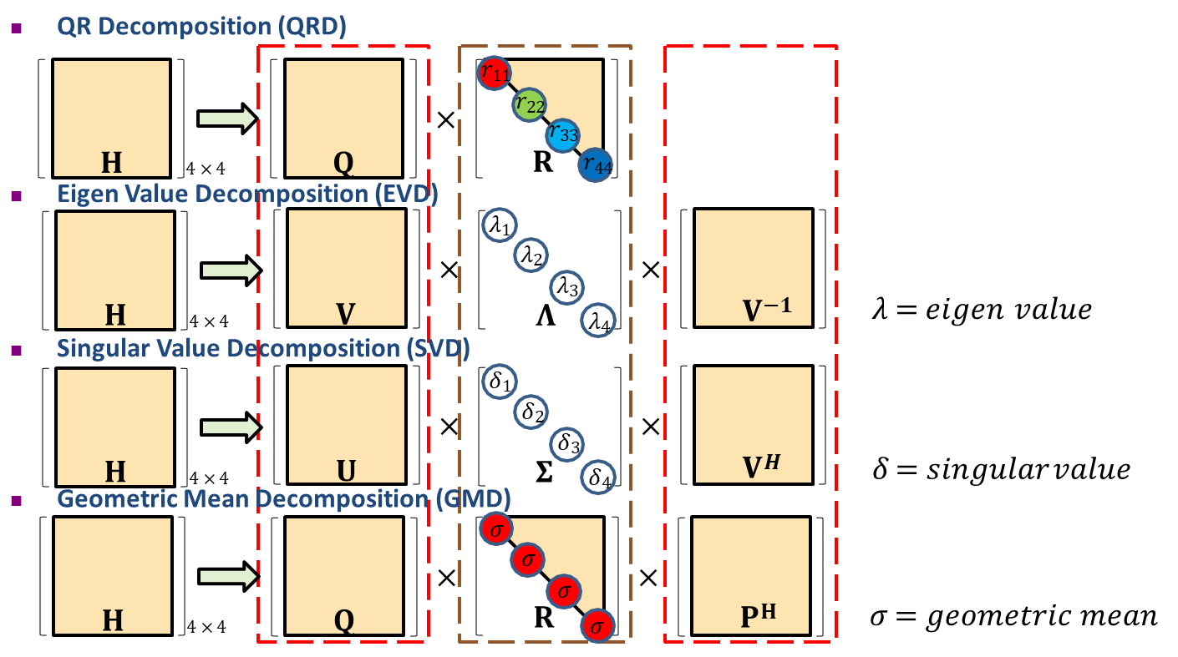
Case Study: Matrix Decompositions
Matrix decomposition plays an important role in signal.
High complexity and long processing time.

Slide 19
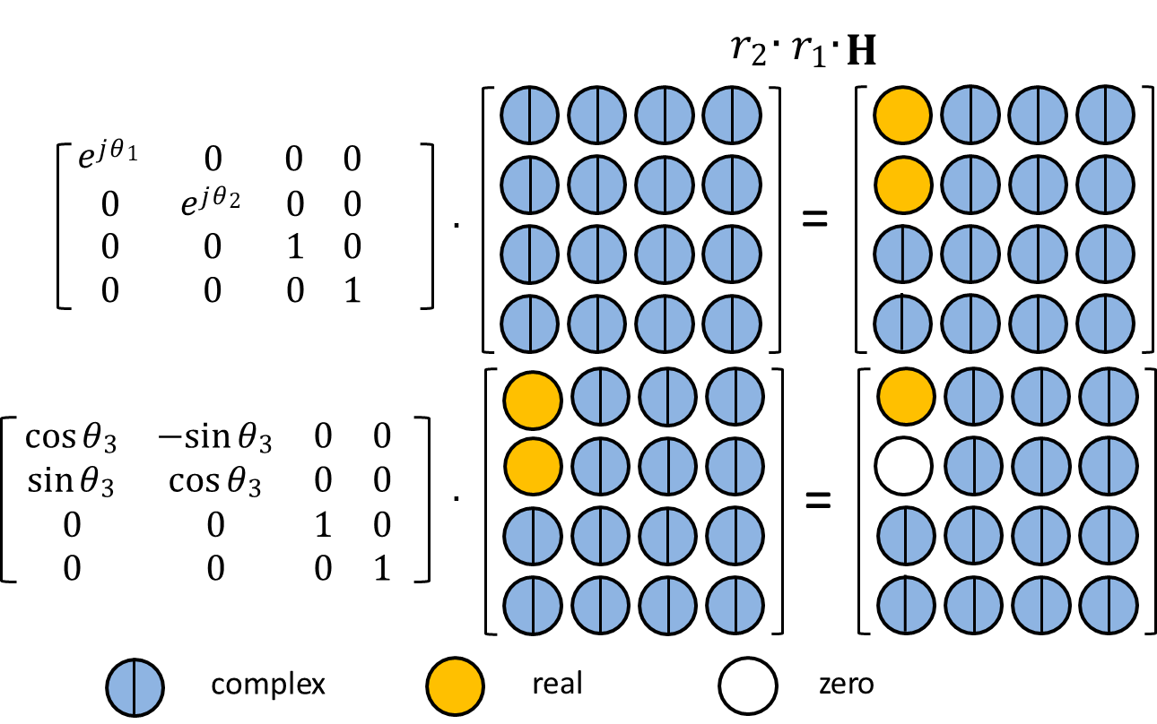
Givens Rotation for QR Decomposition

Slide 20
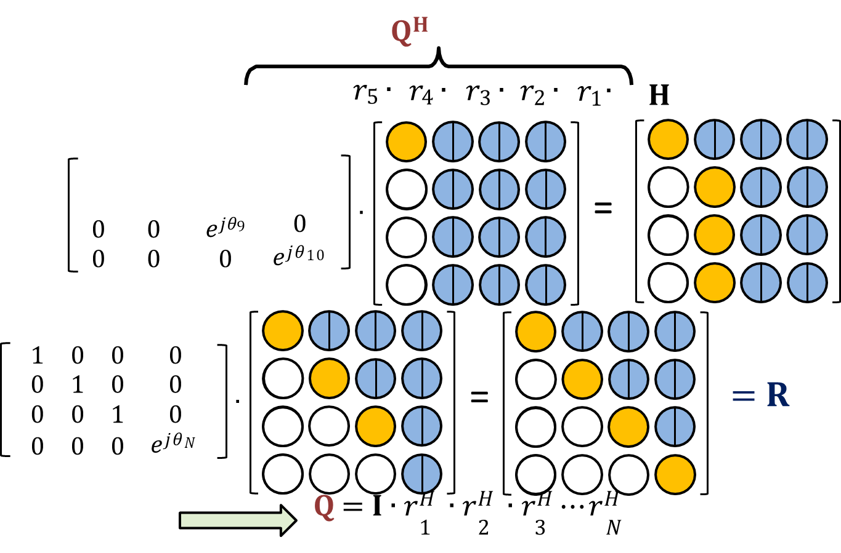
Givens Rotation for QR Decomposition

Slide 21
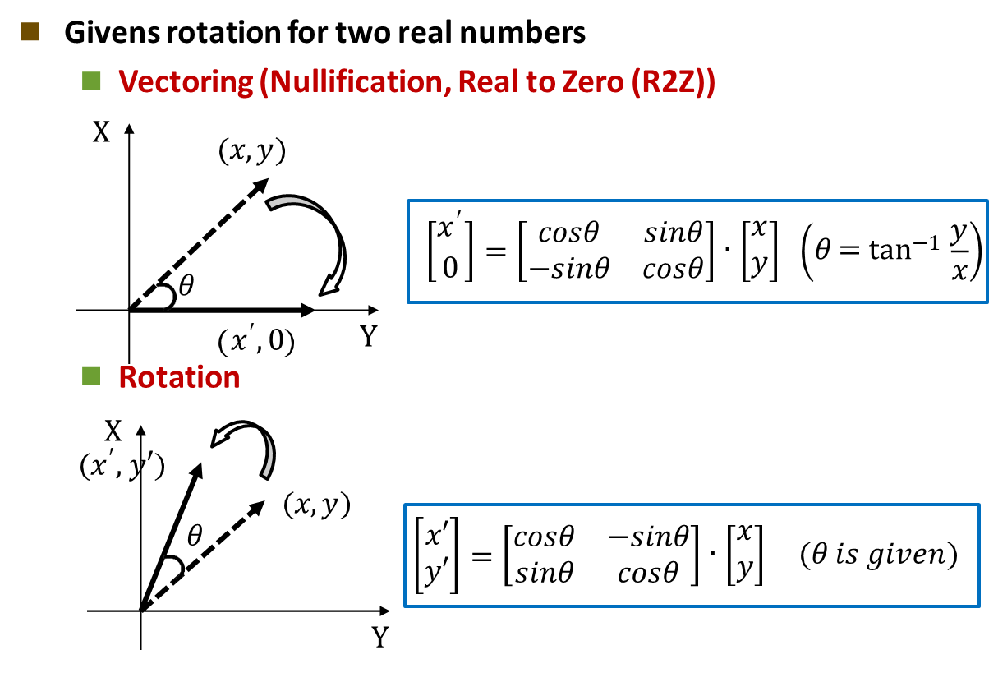
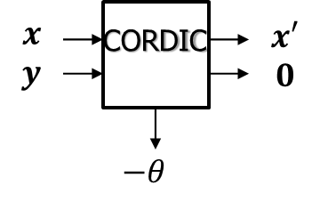
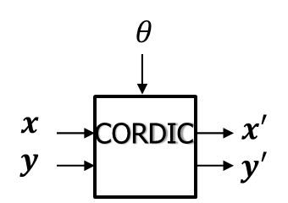
Givens Rotation for QR Decomposition
Givens Rotation based on CORDIC operations.

Slide 22
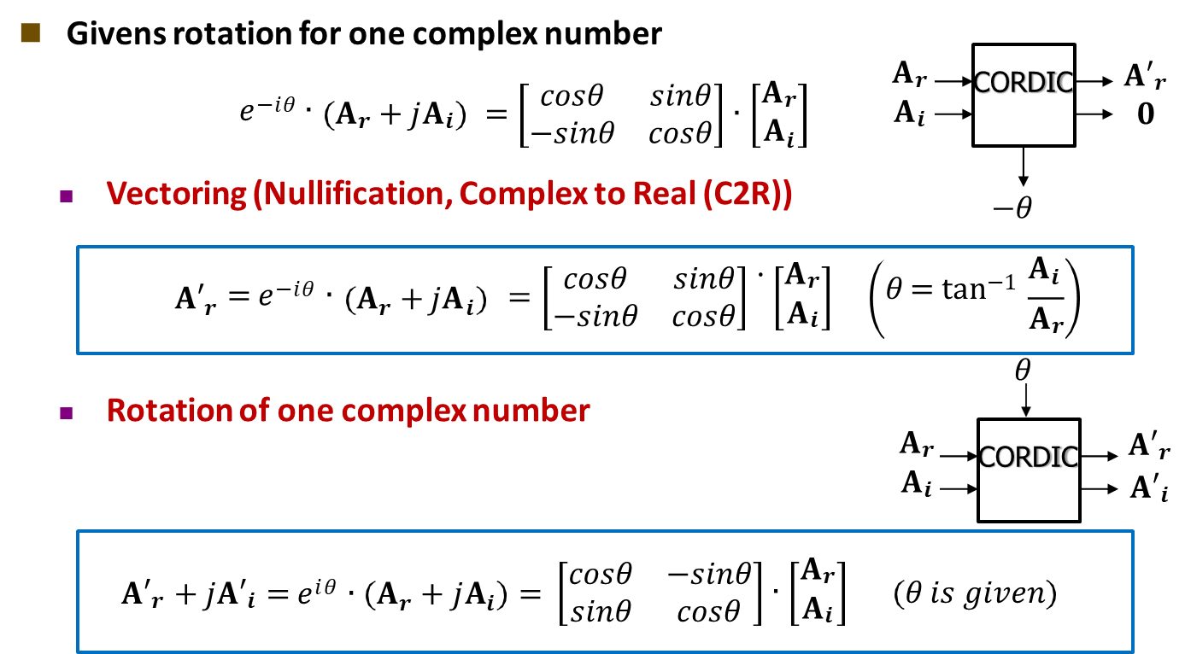
Givens Rotation for QR Decomposition
Givens Rotation based on CORDIC operations.

Slide 23
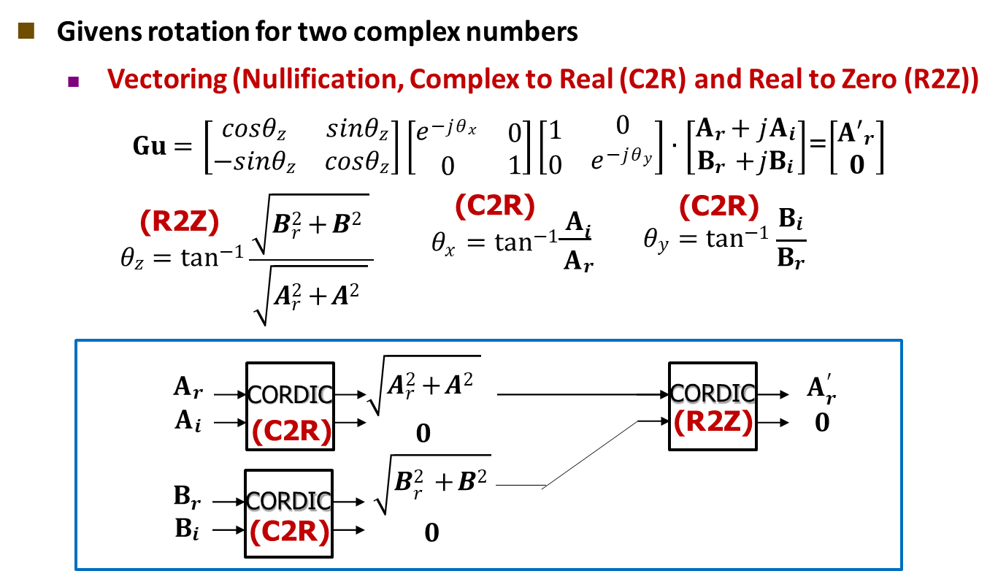
Givens Rotation for QR Decomposition
Givens Rotation based on CORDIC operations.

Slide 24
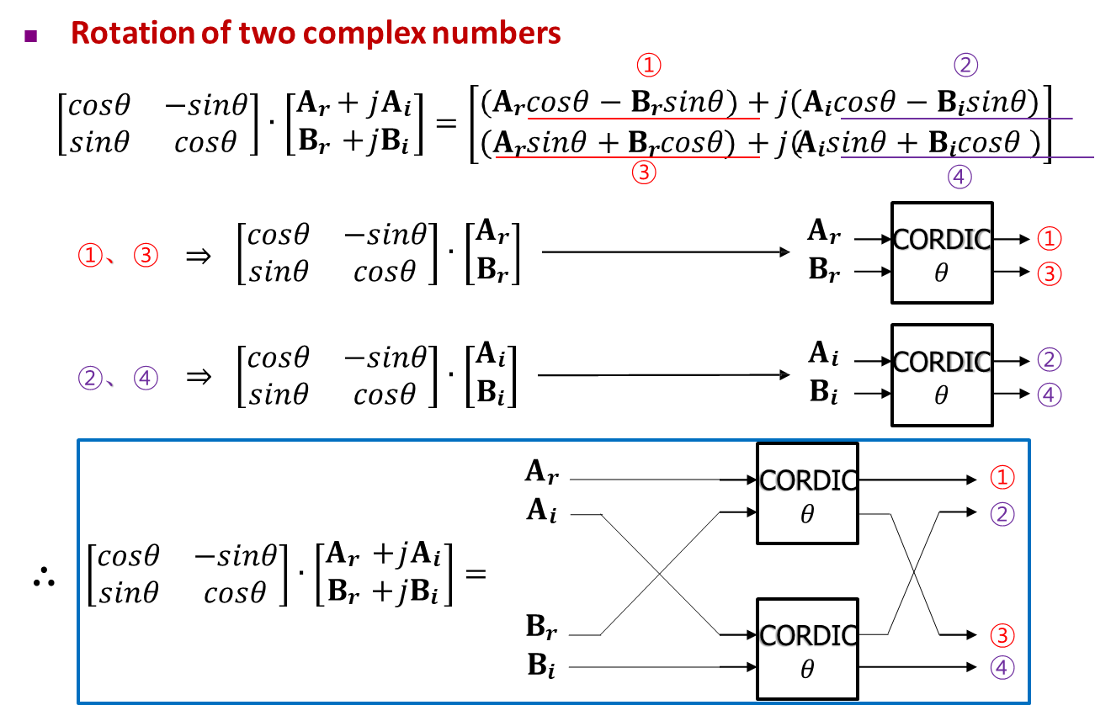
Givens Rotation for QR Decomposition
Givens Rotation based on CORDIC operations.

Slide 25
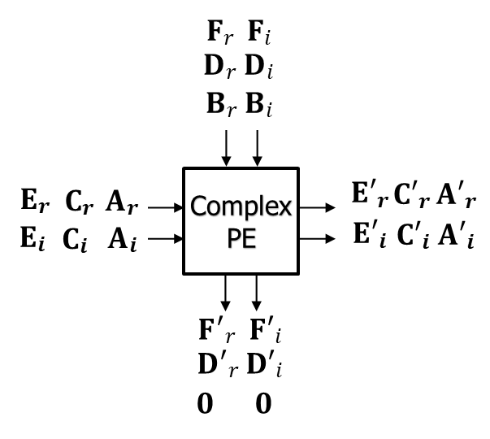
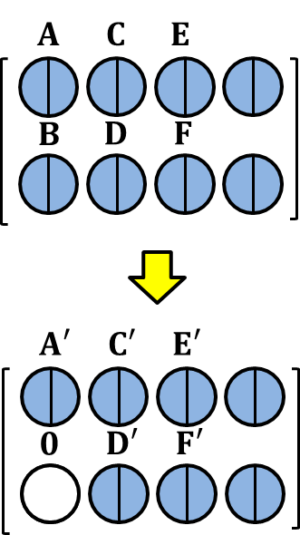
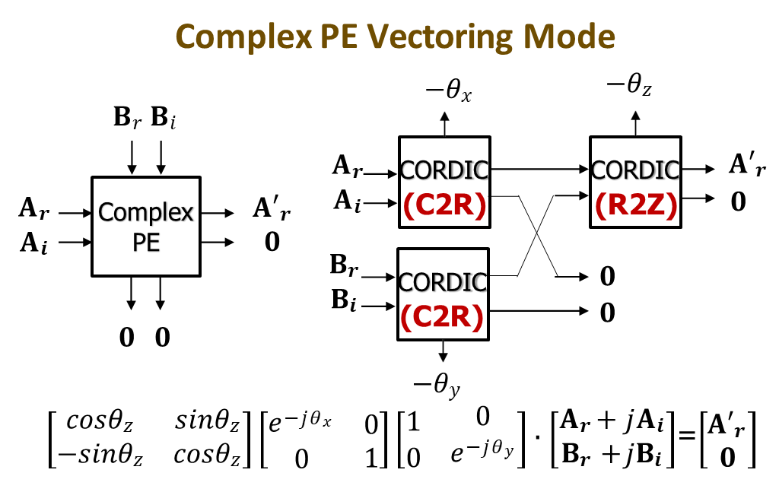
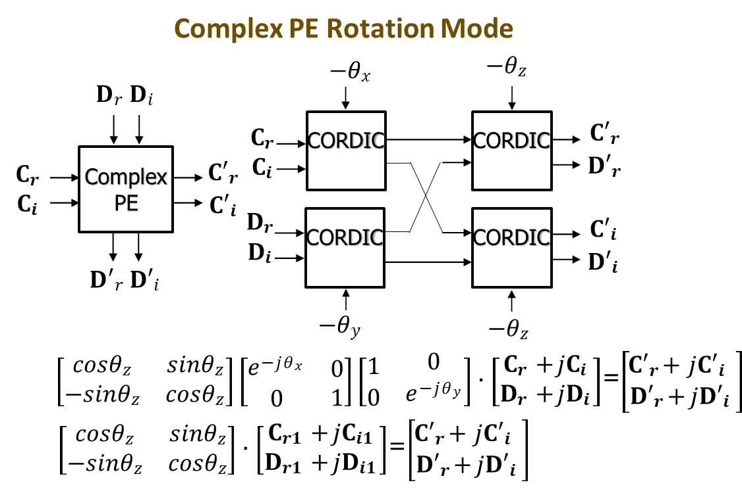
Givens Rotation for QR Decomposition
Architecture design for Givens Rotation based on CORDIC operations.

Slide 26
Givens Rotation for QR Decomposition
Systolic array architecture for Givens Rotation design.

Slide 27
The Design of SVD for MIMO communications
For real/complex matrix 𝐀 ∈ ℂ^{M×N}
  𝐀 = 𝐔𝚺𝐕^{H}
    𝚺 ∈ ℝ^{M×N} is a real non-negative diagonal matrix with entries, known as singular values. Usually, they are arranged in descending order.
𝜎₁ 0 0 𝜎₁
0
0
0
0
0 0 0
𝚺 =
0
⋱ 0
0 𝜎_{𝑀}
𝐔 ∈ ℂ^{M×M} is a real/complex unitary matrix. The column of 𝐔 is called left singular vector
𝐕 ∈ ℂ^{N×N} is a real/complex unitary matrix. The column of 𝐕 is called right singular vector

Slide 28
The Design of Singular Value Decomposition (SVD)
The design of SVD processor
  Jacobi algorithm [1]
    Divide the channel matrix into $2×2$ and upper triangulize the submatrices.
    Diagonalize the submatrix that has been upper triangulized.
  Golub-Kahan algorithm [2]
    Bi-diagonalize the channel matrix.
    Diagonalize the matrix that has been bi-diagonalized.
[1] D. Guenther, R. Leupers, G. Ascheid, “A scalable, multi-mode SVD precoding ASIC based on the cyclic Jacobi method”, IEEE Trans. Circuits Systems I, vol. 63, no. 8, pp. 1283-94, Aug. 2016.
[2] Y.-T. Hwang, K.-T Chen and C.-K Wu, "A high throughput unified SVD/QRD precoder design for MIMO OFDM systems", 2015 IEEE Intl. Conference Digital Signal Processing (DSP), pp. 1148 – 1151, Sept. 2015.

Slide 29
The Design of SVD Processor based on Real Jacobi Algorithm
Diagonalization
For symmetric real matrix 𝐀 ∈ ℝ^{2×2}
^{𝑎}1,1
^{𝑎}2,1
^{𝑎}1,2
^{𝑎}2,2
𝑐𝑜𝑠𝜃
−𝑠𝑖𝑛𝜃
𝑠𝑖𝑛𝜃
𝑐𝑜𝑠𝜃
𝑐 𝑠
−𝑠 𝑐
𝐀 =
𝐉 =
=
^{𝑏}1,1
^{𝑏}2,1
^{𝑏}1,2
^{𝑏}2,2
𝑐𝑜𝑠𝜃
−𝑠𝑖𝑛𝜃
𝑠𝑖𝑛𝜃
𝑐𝑜𝑠𝜃
𝑇
^{𝑎}1,1
^{𝑎}2,1
^{𝑎}1,2
^{𝑎}2,2
𝑐𝑜𝑠𝜃
−𝑠𝑖𝑛𝜃
𝑠𝑖𝑛𝜃
𝑐𝑜𝑠𝜃
𝑻
𝐁 = 𝐉 𝐀𝐉 =
=
If
^{𝑏}1,2 ^{= 𝑏}2,1 ^{= 0 = 𝑐𝑠 𝑎}1,1 ^{− 𝑎}2,2
+ 𝑎_{1,2}(𝑐² − 𝑠²)
we have
^{𝑎}2,2 ^{− 𝑎}1,1 ^{2𝑎}1,2
𝑠𝑔𝑛(𝜌)
𝑡𝑎𝑛𝜃 =
𝜌 + 1 + 𝜌²
𝜌 =

Slide 30









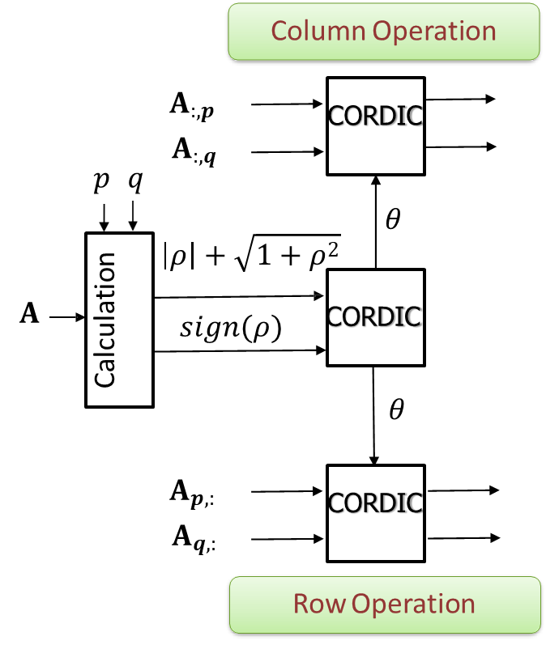
The Design of SVD Processor based on Real Jacobi Algorithm
One sweep
Algorithm: Real Two-Sided Jacobi
Given real symmetric matrix 𝐀 ∈ ℝ^{𝑁×𝑁} 1. for 𝑠𝑤𝑒𝑒𝑝 = 1: 𝑆 2. for 𝑝 = 1: 𝑁 − 1 3. for 𝑞 = 𝑝 + 1: 𝑁 ^{𝑎}𝒒,𝒒^{−𝑎}𝒑,𝒑 4. 𝜌 = ^{2𝑎}𝒑,𝒒 5. 𝜃 = tan⁻¹( ^{𝑠𝑔𝑛(𝜌)} ) , 𝜌 + 1+𝜌² 6. 𝐉 = 𝐈_{𝑁}, 𝐉_{𝑝,𝑝} = 𝐉_{𝑞,𝑞} = 𝑐𝑜𝑠𝜃, 7. 𝐉_{𝑝,𝑞} = −𝐉_{𝑞,𝑝}= 𝑠𝑖𝑛𝜃 8. 𝐀 = 𝐉^{𝑻}𝐀𝐉 9. 𝐕 = 𝐕𝐉 end end end

Slide 31
The Design of SVD Processor based on Complex Jacobi Algorithm

Slide 32
The Design of SVD Processor based on Complex Jacobi Algorithm

Slide 33
The Design of SVD Processor based on Complex Jacobi Algorithm

Slide 34
The Design of SVD Processor based on Complex Jacobi Algorithm
Architecture design for based on CORDIC operations.

Slide 35
The Design of SVD Processor based on Complex Jacobi Algorithm
Architecture design for based on CORDIC operations.

Slide 36
The Design of SVD Processor based on Complex Jacobi Algorithm
Architecture design for based on CORDIC operations.

Slide 37
The Design of SVD Processor based on Complex Jacobi Algorithm
The design of SVD processor based on Jacobi algorithm
  The operation sequence:
  Step 1: unitary transformation for Upper-Triangularization
(1,2) (1,3) (1,4)
(2,3) (2,4)
(3,4)
$$\left[\begin{matrix}\begin{matrix}a_{11} & a_{12} \\ a_{21} & a_{22}\end{matrix} & \begin{matrix}a_{13} & a_{14} \\ a_{23} & a_{24}\end{matrix} \\ \begin{matrix}a_{31} & a_{32} \\ a_{41} & a_{42}\end{matrix} & \begin{matrix}a_{33} & a_{34} \\ a_{43} & a_{44}\end{matrix}\end{matrix}\right]$$
Iterative
$$Σ^{(k+1)}=J_{l1}Σ^{(k)}J_{r1}=\left[\begin{matrix}e^{{jθ}_{α}}cosφ & {−e}^{{jθ}_{β}}sinφ \\ e^{{jθ}_{α}}sinφ & e^{{jθ}_{β}}cosφ\end{matrix}\right]\left[\begin{matrix}{Ae}^{{jθ}_{a}} & {Be}^{{jθ}_{b}} \\ {Ce}^{{jθ}_{c}} & {De}^{{jθ}_{d}}\end{matrix}\right]\left\lceil \begin{matrix}e^{{jθ}_{γ}}cosψ & e^{{jθ}_{γ}}sinψ \\ {−e}^{{jθ}_{δ}}sinψ & e^{{jθ}_{δ}}cosψ\end{matrix}\right\rceil$$
$$=\left[\begin{matrix}{We}^{{jθ}_{w}} & {Xe}^{{jθ}_{x}} \\ 0 & Z\end{matrix}\right]$$
$$θ_{α}=θ_{β}=\frac{−(θ_{d}+θ_{c})}{2}, θ_{γ}={−θ}_{δ}=\frac{(θ_{d}−θ_{c})}{2},φ=0, and ψ=\tan^{−1}\left(\frac{C}{D}\right)$$
D. Guenther, R. Leupers, G. Ascheid, “A scalable, multi-mode SVD precoding ASIC based on the cyclic Jacobi method”, IEEE TCAS-I, vol. 63, no. 8, pp. 1283-94, Aug. 2016.

Slide 38
The Design of SVD Processor based on Complex Jacobi Algorithm
The design of SVD processor based on Jacobi algorithm
  Step 2: unitary transformation for Diagonalization
$${Σ^{(k+1)}=J}_{l2}Σ^{(k)}J_{r2}=\left[\begin{matrix}e^{{jθ}_{ξ}}cosλ & {−e}^{{jθ}_{η}}sinλ \\ e^{{jθ}_{ξ}}sinλ & e^{{jθ}_{η}}cosλ\end{matrix}\right]\left[\begin{matrix}{We}^{{jθ}_{w}} & {Xe}^{{jθ}_{x}} \\ 0 & Z\end{matrix}\right]\left\lceil \begin{matrix}e^{{jθ}_{ζ}}cosρ & e^{{jθ}_{ζ}}sinρ \\ {−e}^{{jθ}_{ω}}sinρ & e^{{jθ}_{ω}}cosρ\end{matrix}\right\rceil$$
$$=\left[\begin{matrix}P & 0 \\ 0 & Q\end{matrix}\right]$$
$$θ_{ξ}=\frac{−(θ_{x}+θ_{w})}{2}, θ_{η}=θ_{ζ}={−θ}_{ω}=\frac{(θ_{x}−θ_{w})}{2}, and \tan\left(λ±ρ\right)=−\left(\frac{X}{Z∓W}\right)$$
CORDIC is efficient for the matrix upper-triangularization and diagonalization
D. Guenther, R. Leupers, G. Ascheid, “A scalable, multi-mode SVD precoding ASIC based on the cyclic Jacobi method”, IEEE TCAS-I, vol. 63, no. 8, pp. 1283-94, Aug. 2016.

Slide 39
The Design of SVD Processor based on Complex Jacobi Algorithm
The design of SVD processor based on Jacobi algorithm
  Step 1: unitary transformation for Upper-Triangularization
  Evaluate $θ_{c}$, C, $θ_{d}$ and D by using vectoring-mode CORDIC
  Find out $θ_{α}$, $θ_{β}$, $θ_{γ}$, $θ_{δ}$
  Evaluate $ψ$ by using vectoring-mode CORDIC
  Rotate the first and second row elements based on ${jθ}_{α}$ and ${jθ}_{β}$
  Rotate the first and second column elements based on ${jθ}_{γ}$ and ${jθ}_{δ}$
  Rotate the first and second column elements based on $ψ$
$$\left[\begin{matrix}e^{{jθ}_{α}}cosφ & {−e}^{{jθ}_{β}}sinφ \\ e^{{jθ}_{α}}sinφ & e^{{jθ}_{β}}cosφ\end{matrix}\right]\left[\begin{matrix}{Ae}^{{jθ}_{a}} & {Be}^{{jθ}_{b}} \\ {Ce}^{{jθ}_{c}} & {De}^{{jθ}_{d}}\end{matrix}\right]\left\lceil \begin{matrix}e^{{jθ}_{γ}}cosψ & e^{{jθ}_{γ}}sinψ \\ {−e}^{{jθ}_{δ}}sinψ & e^{{jθ}_{δ}}cosψ\end{matrix}\right\rceil =\left[\begin{matrix}{We}^{{jθ}_{w}} & {Xe}^{{jθ}_{x}} \\ 0 & Z\end{matrix}\right]$$
$$θ_{α}=θ_{β}=\frac{−(θ_{d}+θ_{c})}{2}, θ_{γ}={−θ}_{δ}=\frac{(θ_{d}−θ_{c})}{2}, ψ=\tan^{−1}\left(\frac{C}{D}\right)$$
D. Guenther, R. Leupers, G. Ascheid, “A scalable, multi-mode SVD precoding ASIC based on the cyclic Jacobi method”, IEEE TCAS-I, vol. 63, no. 8, pp. 1283-94, Aug. 2016.

Slide 40
The Design of SVD Processor based on Complex Jacobi Algorithm
The design of SVD processor based on Jacobi algorithm
  Step 2: unitary transformation for Diagonalization
  Evaluate $θ_{w}$, W, $θ_{x}$ and X by using vectoring-mode CORDIC
  Find out $θ_{ξ}$, $θ_{η}$, $θ_{ζ}$, $θ_{ω}$
  Evaluate $λ$ and $ρ$ by using vectoring-mode CORDIC
  Rotate the first and second row elements based on ${jθ}_{ξ}$ and ${jθ}_{η}$
  Rotate the first and second column elements based on ${jθ}_{ζ}$ and ${jθ}_{ω}$
  Rotate the first and second row elements based on $λ$
  Rotate the first and second row elements based on $ρ$
$$\left[\begin{matrix}e^{{jθ}_{ξ}}cosλ & {−e}^{{jθ}_{η}}sinλ \\ e^{{jθ}_{ξ}}sinλ & e^{{jθ}_{η}}cosλ\end{matrix}\right]\left[\begin{matrix}{We}^{{jθ}_{w}} & {Xe}^{{jθ}_{x}} \\ 0 & Z\end{matrix}\right]\left\lceil \begin{matrix}e^{{jθ}_{ζ}}cosρ & e^{{jθ}_{ζ}}sinρ \\ {−e}^{{jθ}_{ω}}sinρ & e^{{jθ}_{ω}}cosρ\end{matrix}\right\rceil =\left[\begin{matrix}P & 0 \\ 0 & Q\end{matrix}\right]$$
$$θ_{ξ}=\frac{−(θ_{x}+θ_{w})}{2}, θ_{η}=θ_{ζ}={−θ}_{ω}=\frac{(θ_{x}−θ_{w})}{2}, \tan\left(λ±ρ\right)=−\left(\frac{X}{Z∓W}\right)$$
D. Guenther, R. Leupers, G. Ascheid, “A scalable, multi-mode SVD precoding ASIC based on the cyclic Jacobi method”, IEEE TCAS-I, vol. 63, no. 8, pp. 1283-94, Aug. 2016.

Slide 41


Remarks
An efficient design of signal processing algorithms and architectures requires a good understanding of both.
Different design approaches are given in this lecture.
Different paradigms of computing capabilities and flexibilities in different layers of modern communication systems.
Cross-layer and multidisciplinary efforts.

Slide 42


